Slide 1

DevOps & Cloud Infrastructure SEIS 6XX Week 7
Jason Baker
Adjunct Instructor
Graduate Programs in Software
University of St. Thomas
St. Paul, MN

Slide 2
Agenda
Application architectures
N-tier
Service oriented architecture (SOA)
Micro-services architecture
APIs
REST/ JSON/ YAML

Slide 3
Application Architecture
Application architecture determines how we connect and configure infrastructure components:
Communication channels
Resiliency
Scalability
Security
Question: Does software determine infrastructure or does infrastructure determine software?

Slide 4
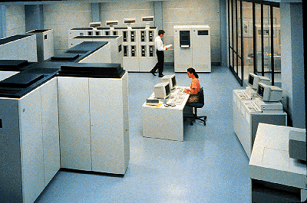
In the beginning…
1-tier architecture
Single centralized computing on mainframes
Applications accessed via dumb terminals
Advantages:
Only one system to maintain
Infrastructure never changes
Disadvantages:
Can’t scale beyond one system
Software tightly coupled to infrastructure

Slide 5
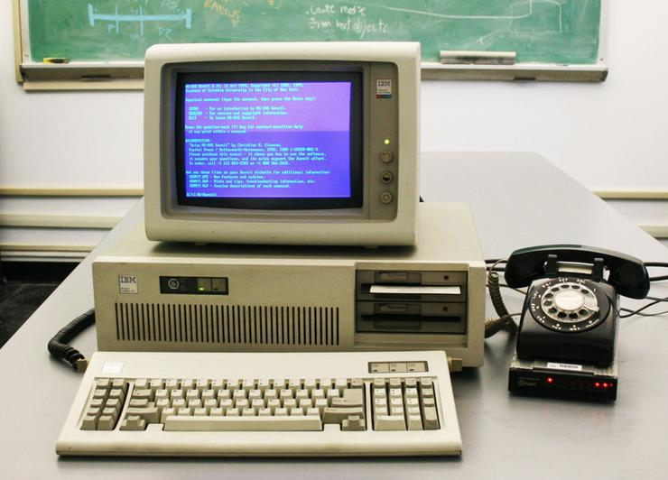
The PC Era
2-tier architecture (Client/Server)
PC’s powerful enough to run a software client application
Fat clients: perform some business logic on the client
Thin clients: mostly just provide user interface
Advantages:
User friendly
PC could access several different servers
Network = longer distance
Disadvantages:
Greater communication and software complexity

Slide 6
Client-Server Architecture
Servers provide services that are consumed by clients
Servers don’t need to know anything about clients, but clients must know about servers.
Clients and servers are logical processes and could be running on the same physical hardware.

Slide 7
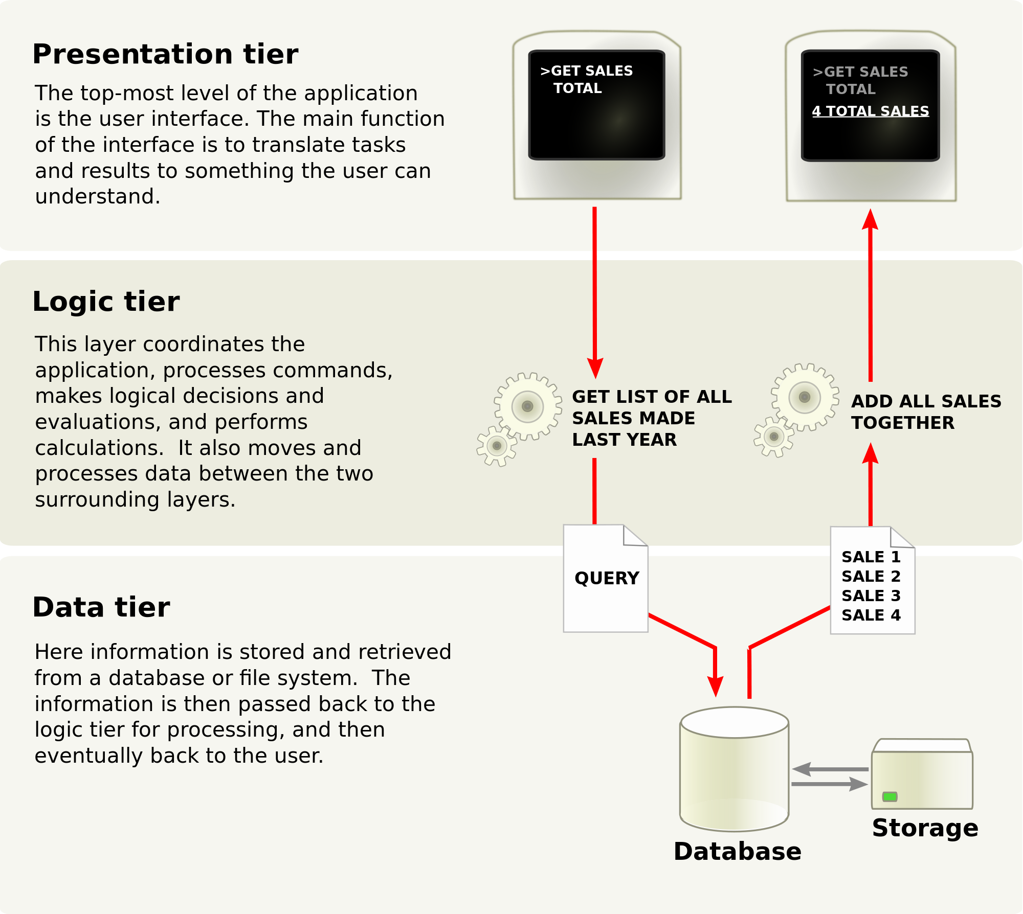
Client-Server Application Layers

Slide 8
Client-Server Application Layers
Presentation layer does not have direct access to the data layer – database structure is hidden.
Each tier can scale horizontally, independently of other tiers.
Can use load balancing at each layer to distribute requests
Can also potentially cache requests between layers to improve performance

Slide 9
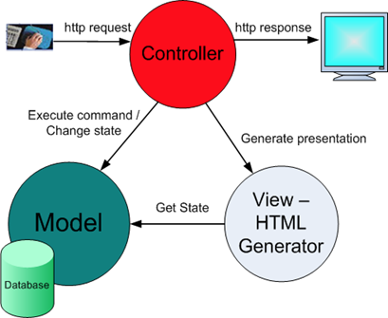
Client-Server Application Layers
Application Layers map to MVC software model.
Presentation = View
Logic = Controller
Model = Data

Slide 10
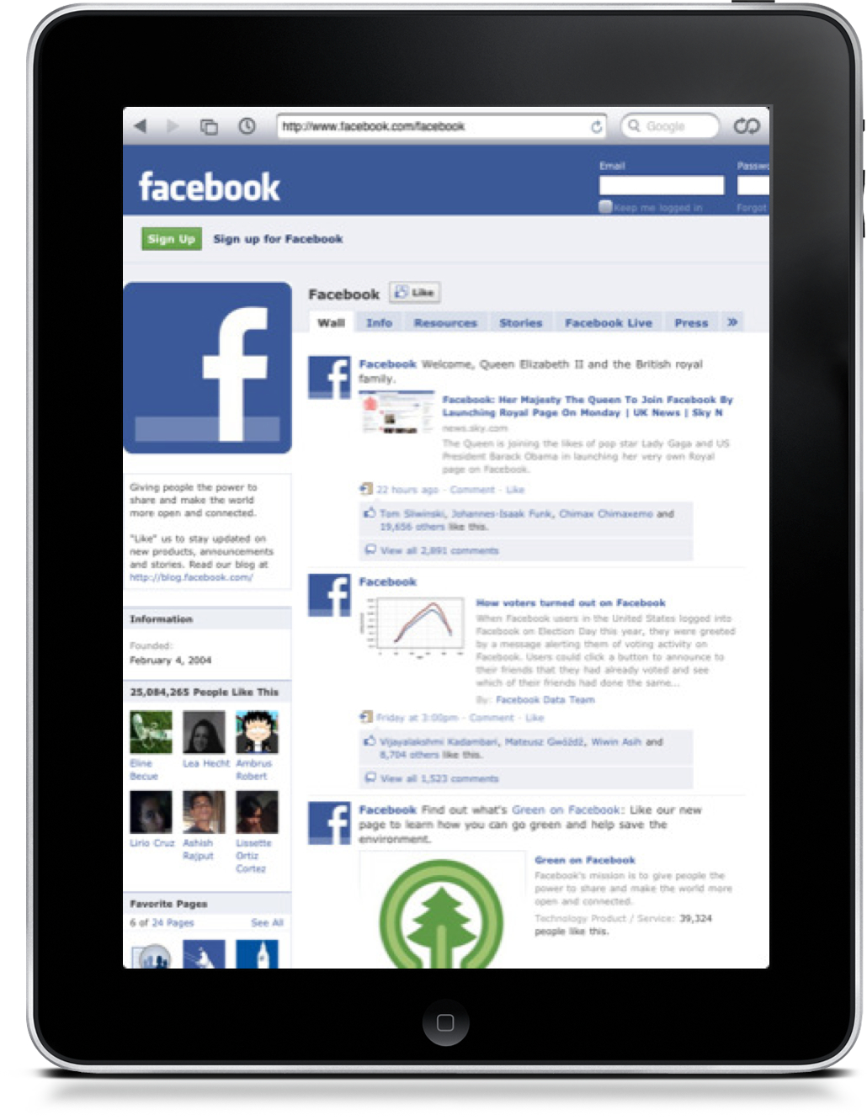
The Web Era
3-tier (or 4-tier) architecture (Client/Server)
Presentation, logic, and data layers deployed on separate systems
Standardize on a presentation layer (browser)
Advantages:
Flexible presentation layer
Global scale applications via Internet
Access from nearly any device
Disadvantages:
More complex to scale
Greater support requirement (always on 24x7)

Slide 11
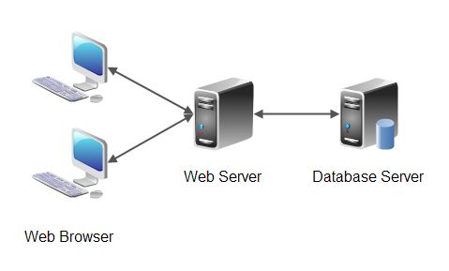
3-tier Web Application

Slide 12
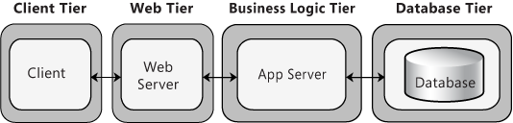
4-tier Web Application

Slide 13
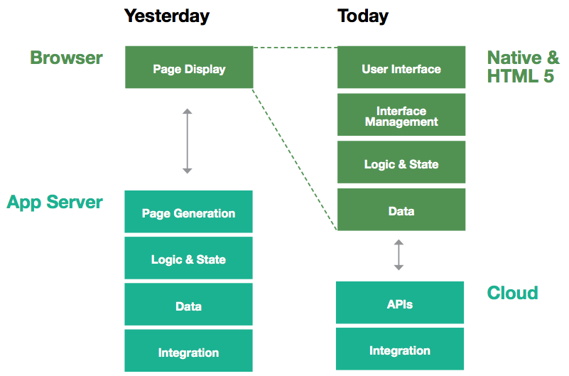
Modern Web Application Architecture

Slide 14
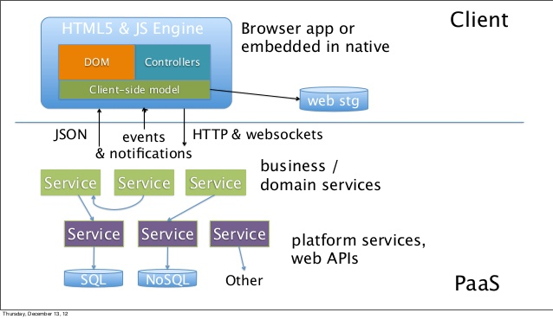
Modern Web Application Architecture

Slide 15
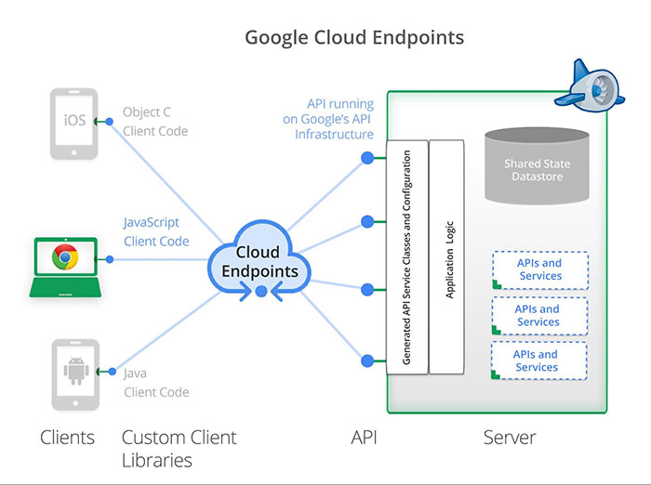
Cloud Application Architecture

Slide 16
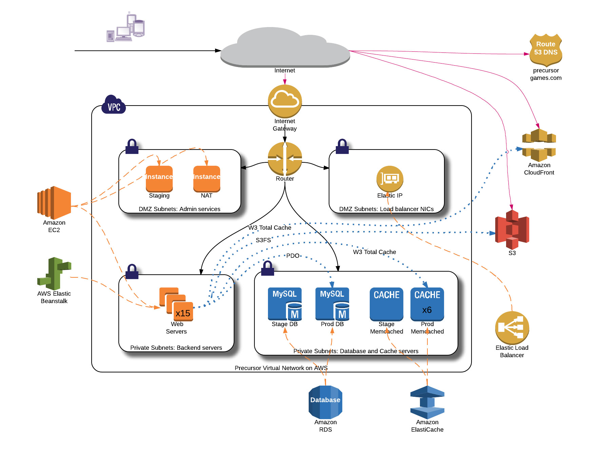

Slide 17
Application Programming Interface (API)
An API provides a programmatic method to interact with a software application
Allows software to communicate with other software (client-server)
Wide variety of different API formats in the marketplace
Most APIs provide some form of CRUD functionality
Create, Read, Update, Delete
APIs often secured using an access token

Slide 18
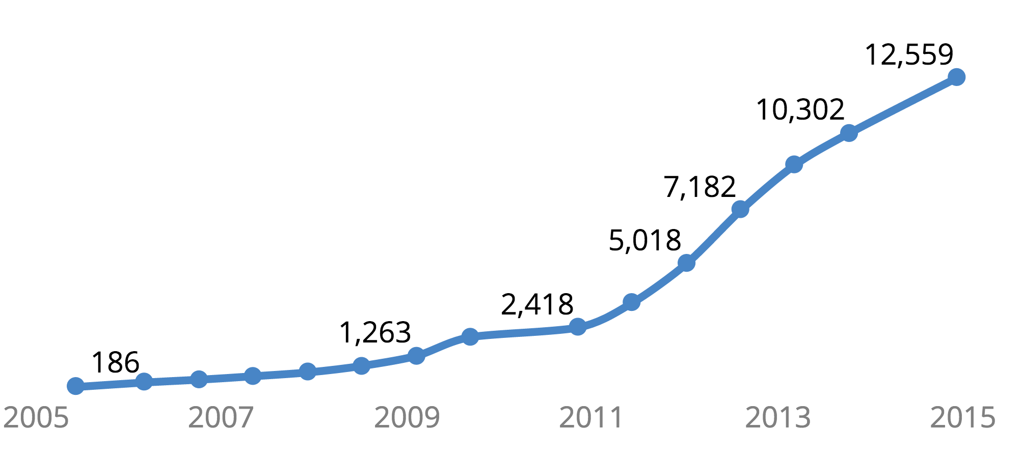
Growth of Public APIs
Source: Programmable Web

Slide 19
Why APIs Matter
Only software developers deal with APIs… (not really)
API usage impacts network architecture and performance, service scaling, database configuration, etc
APIs provide an abstraction layer to decouple services from one another.
Don’t need to understand how an application works, just how to talk to it.
Services may be provided by anyone, anywhere
APIs form the service scaffolding upon which we build applications.
Quickly build applications leveraging services built by others.

Slide 20
Why (Web) APIs Matter
Web API: an API that uses HTTP for transport
Most web-based applications use some form of web API
XML-RPC, SOAP, REST, etc
AWS REST interface
Other APIs like ODBC are used to talk to databases.

Slide 21
Web API Data Formats
Web APIs generally use two different data formats to communicate
Extensible Markup Language (XML)
JavaScript Object Notation (JSON)
Serialization: convert an application object into a text string for storage or transmission
Application serializes data into XML/JSON and sends it to another application where the data is de-serialized.

Slide 22
XML
XML is a meta-language: it’s used to define other languages
XML uses markup (<document></document>)
XML is extensible: you can use it to create your own tags
XML is a data-description language that allows us to describe the data in a document
We commonly use XML in IT to:
transmit complex data in APIs
store application and service configuration settings

Slide 23
XML Example
<breakfast_menu>
<food>
<name>Belgian Waffles</name>
<price>$6.99</price>
<description>
Our wonderful Belgian Waffles
</description>
<calories>650</calories>
</food>
</breakfast_menu>

Slide 24
JSON
Very light-weight data-interchange format
Easy for humans to read and machines to parse
“self-describing”
Based on subset of JavaScript programming language, but it’s completely language independent
Built on two structures:
Name/value pairs (object/hash)
Ordered lists (array)
Values can be:
String, number, object, array, true, false, null

Slide 25
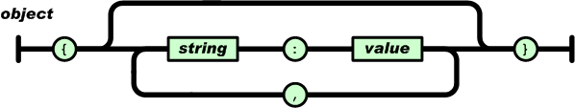
JSON Object Syntax
An Object:
Unordered set of name/value pairs
Object begins with { and ends with }
Each name followed by : (colon) and name pairs are separated by , (comma)
{ “name” : “Allie” }
{ “work” : “Target”, “home” : “Minneapolis” }

Slide 26
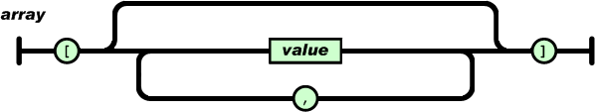
JSON Object Syntax
An Array:
Ordered collection of values
Array begins with [ and ends with ]
Values are separated by , (comma)
{ “employers” : [ “Target”, “Cargill”, “Medtronic” ] }
# nesting objects/arrays
{
“employer” : { “name” : “United Health”,
“employees” : [ “John”, “Miguel”, “Heather” ]
}
}

Slide 27
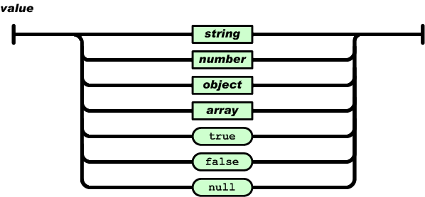
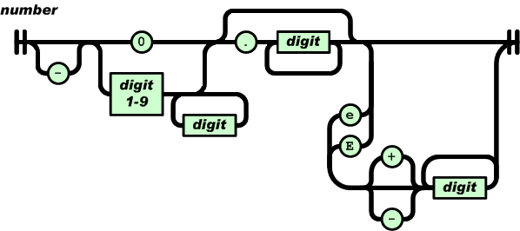
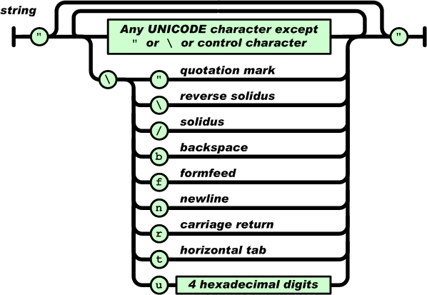
JSON Value Syntax

Slide 28
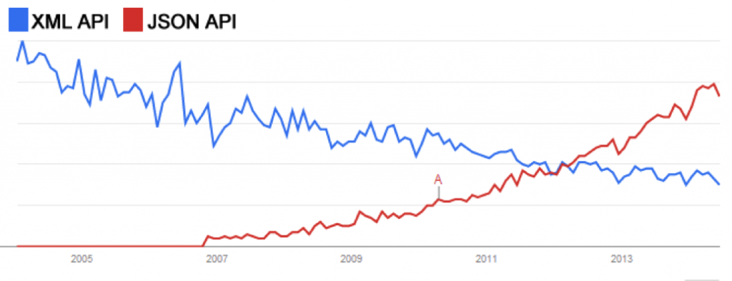
XML vs. JSON Adoption

Slide 29
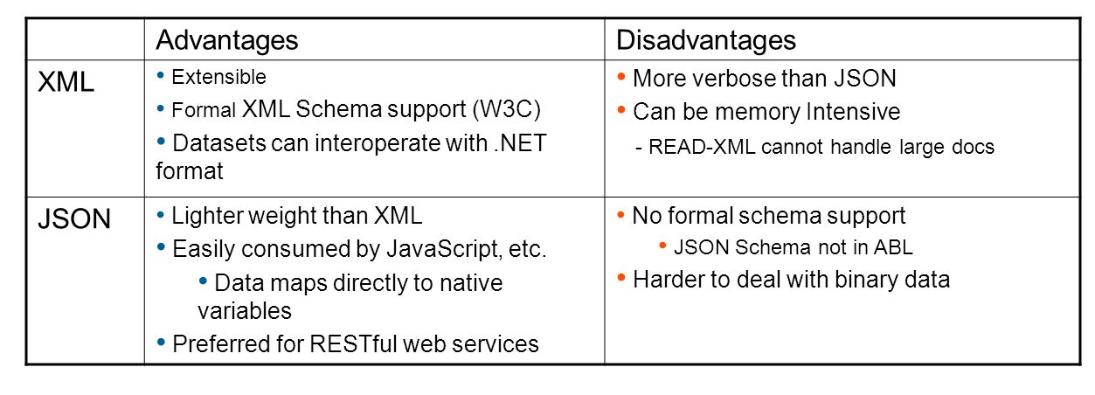
XML vs. JSON

Slide 30
XML vs. JSON
<breakfast_menu>
<food>
<name>Belgian Waffles</name>
<price>$6.99</price>
<description>
Our wonderful Belgian Waffles
</description>
<calories>650</calories>
</food>
</breakfast_menu>
{ “breakfast_menu”:
{ “food”:
[
{ “name”:”Belgian Waffles”,
“price”:”$6.99”,
“description”:”Our wonderful Belgian Waffles”,
“calories”:650
}
]
}
}

Slide 31
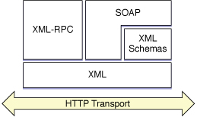
Web API Types
XML-RPC, SOAP & REST use HTTP for transport
XML-RPC & SOAP use XML for data
REST can use XML or JSON
XML-RPC: remote procedure call embedded within an XML document
SOAP: protocol based on WSDL (Web Services Description Language) that is a more advanced version of XML-RPC; (Microsoft,1998)
REST (Represetational State Transfer): a data exchange architecture using HTTP and XML, JSON, or text data

Slide 32
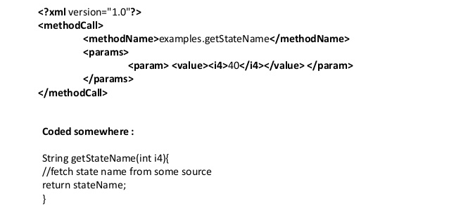
XML-RPC Example

Slide 33
SOAP Request Example
POST /calendar-request HTTP/1.1
Host: foo.bar.net
Content-Type: text/plain; charset=“utf-8”
Content-Length: 507
<SOAP-ENV:Envelope
xmlns:SOAP-ENV=“http://schemas.xmlsoap.org/soap/encoding/”
SOAP-ENV:encodingStyle=“http://schemas.xmlsoap.org/soap/encoding/”
>
<SOAP-ENV:Body>
<c:AddListing xmlns:c=“ http://foo.bar.net/soap-example/calendar “>
<c:when>
<c:Date>
<day>21</day><month>6</month><year>2012</year>
</c:Date>
</c:when>
<c:what>Meeting with management team at the office.</c:what>
</c:AddListing>
</SOAP-ENV:Body>
</SOAP-ENV:Envelope>

Slide 34
REST
It’s not a protocol, it’s an architectural approach.
Industry debate: What does it mean to be RESTful?
Key principle: Be stateless
Server does not store any information about the client, so any server can support any client at anytime (no sticky sessions)
Design patterns describing how to exchange data using Uniform Resource Identifiers (URI) and HTTP methods
Individual URIs are known as endpoints
HTTP methods correspond to CRUD operations

Slide 35
REST HTTP Methods
CRUD / SQL Operation | REST HTTP Method
Create/ Insert | POST
Read/ Select | GET
Update/ Update | PUT
Delete/ Delete | DELETE

Slide 36
REST URI Design
URI | HTTP Method | Action
/user/ | GET | Get all users in system
/user/3 | GET | Get user with ID = 3
/user/ | POST | Add a new user
/user/3 | PUT | Update user with ID = 3
/user/3 | DELETE | Delete user with ID = 3
/user/3/accounts | GET | Get all accounts for user 3

Slide 37
REST HTTP Status
HTTP Status Code | Description
200 | O
201 | Resource created
204 | No content
400 | Bad Request
401 | Unauthorized
404 | No found
405 | Method not allowed
500 | Internal server error

Slide 38
REST Example
URI | HTTP Method | Description
/user/ | POST | Add a new user
Request
HTTP Method: POST
HTTP BODY:
{
“user”:”Benjamin”
}
Response
HTTP Status 201
HTTP BODY:
{
“response”:”ok”
}

Slide 39
SOAP vs. REST
SOAP | REST
Protocol | Architecture
XML-only | XML, JSON, CSV, text
SMTP, HTTP | HTTP-only
More complex | Fast, lightweight
State-ful specification | Stateless specification
Named methods | URI and HTTP methods (GET, PUT, etc)

Slide 40
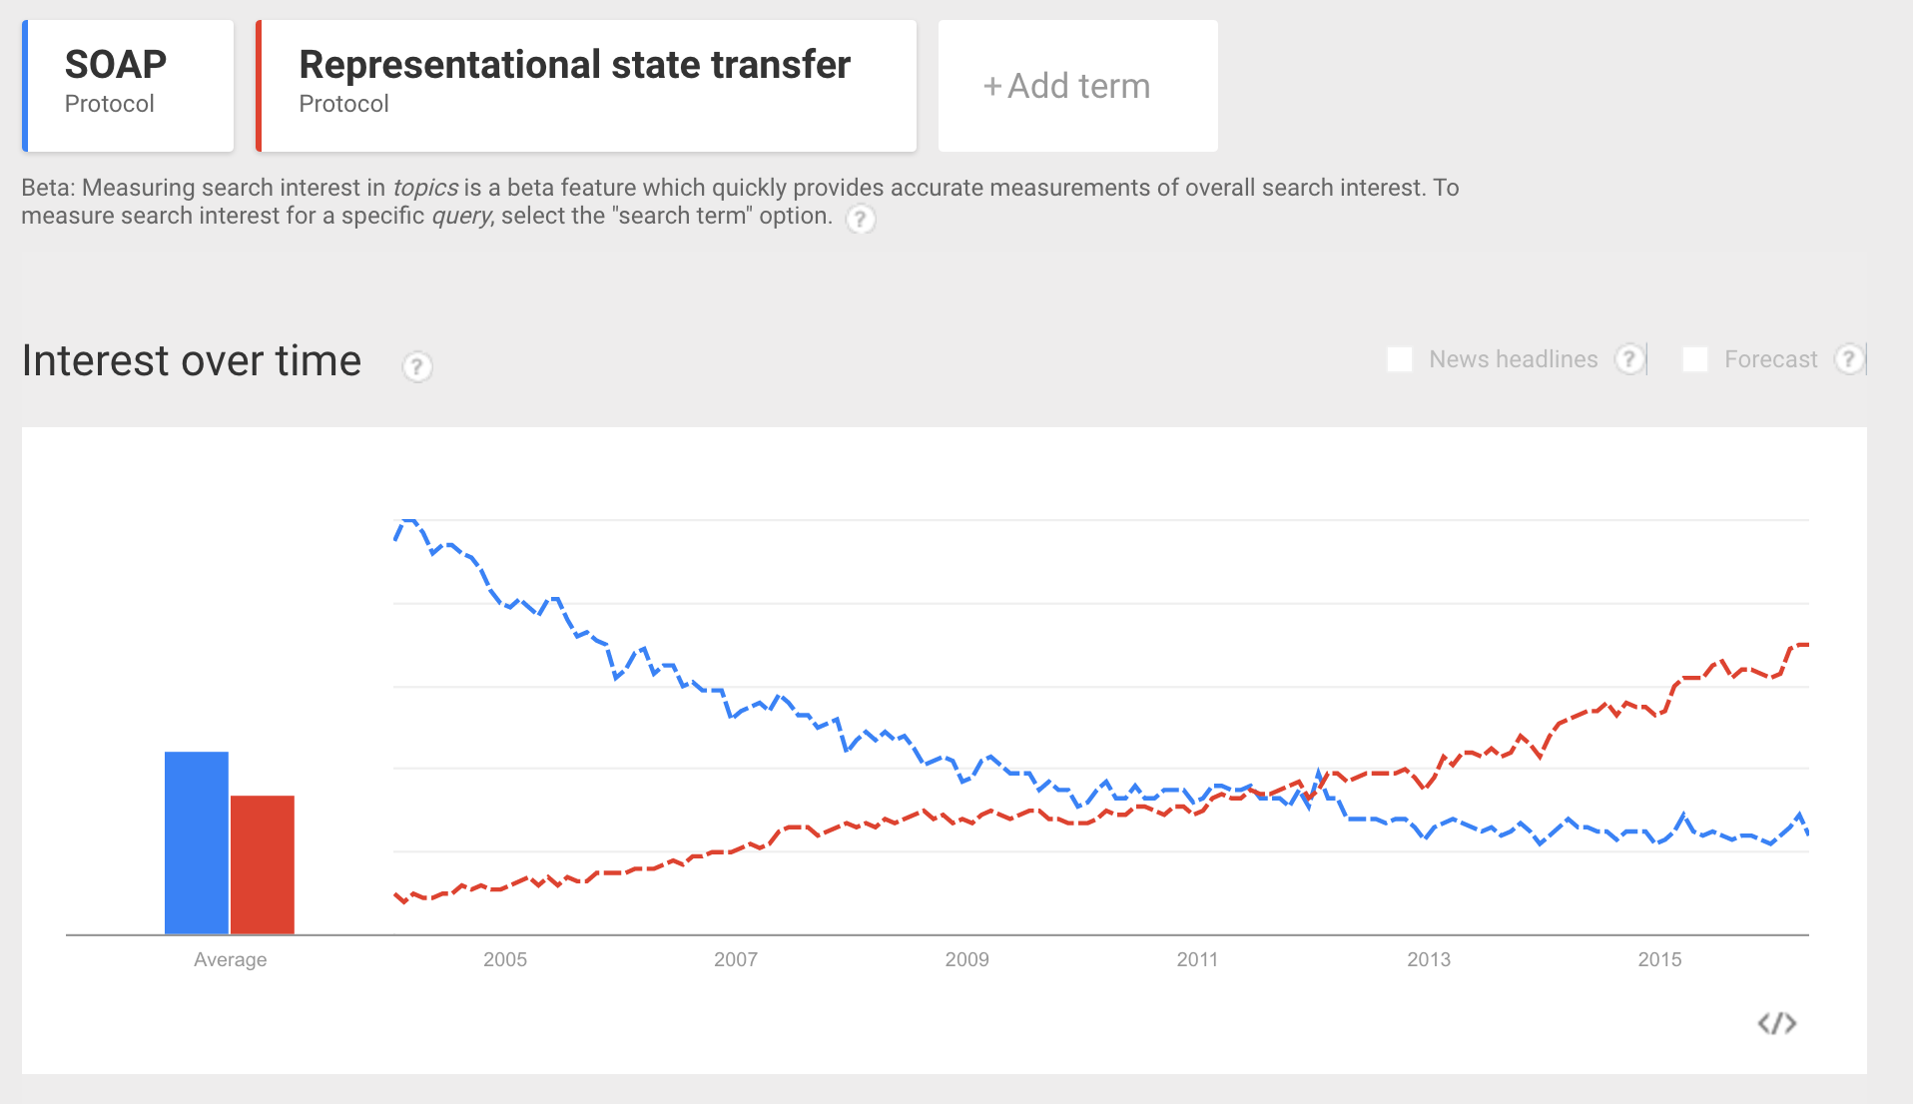
SOAP vs. REST
Source: google.com/trends

Slide 41
JSON Revisited
JSON isn’t just used for data exchange, it’s also used as a storage format
MongoDB uses a JSON-like format called BSON (Binary JSON) to store data
JSON is primarily used by web services; YAML (a sort of JSON superset) is more popular for data processing and configuration

Slide 42
YAML
YAML Ain’t Markup Language (YAML)
Human friendly data serialization standard for all programming languages
Benefits:
Very simple to use
Human readable
Information can easily be translated to multiple programming language types

Slide 43
YAML Rules
Basic rules
YAML files should end with .yaml extension
YAML is case sensitive
YAML does not allow tabs, use space instead.
Indentation (spaces) have meaning!
Data begins with 3 dashes “---” (optional)
See yaml.org for specific requirements

Slide 44
YAML Data Types
Scalars:
Integer: 25
String: “25”
Float: 25.0
Boolean: Yes
Sequences (arrays):
- Cat
- Dog
- Goldfish
fish: [Cat, Dog, Goldfish]
Mappings (hashes):
animal : pets

Slide 45
JSON vs. YAML Example
{ “breakfast_menu”:
{ “food”:
[
{ “name”:”Belgian Waffles”,
“price”:”$6.99”,
“description”:”Our wonderful Belgian Waffles”,
“calories”:650
}
]
}
}
---
breakfast_menu:
food:
- name: Belgian Waffles
price: "$6.99"
description: Our wonderful Belgian Waffles
calories: 650

Slide 46
Homework
Assignment 7
Read Web Operations Chapter 5
Read Practice of Cloud Systems Administration Chapter 5

